Slide 1
EE 1520 計算機概論二 （一一三學年下學期） Introduction to Computer Science (II) Slide Set 04
S. Felix Wu
sfelixwu@gs.ncku.edu.tw
https://github.com/sfelixwu/ee1520
https://www.youtube.com/@sfelixwu
https://discord.gg/PrJKQsKT

Slide 2
JSON
Object Data Description
Procedure Programming vs Object-Oriented Programming

Slide 3
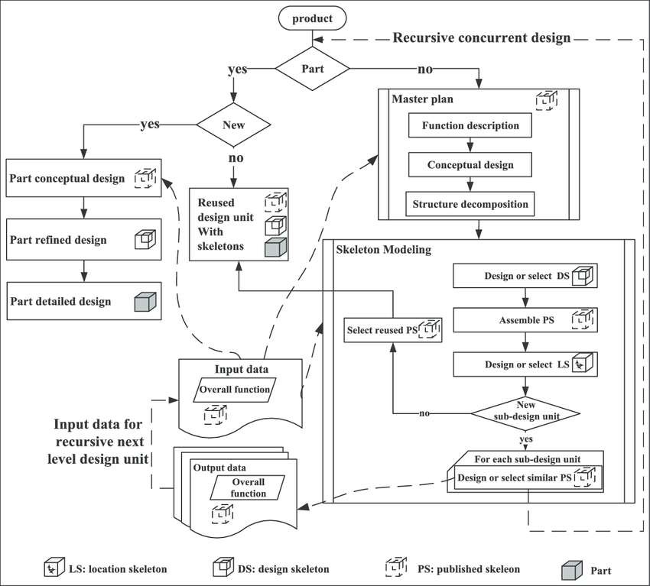
Control-Flow
driven
Data-driven
Data Abstraction
driven
Modeling the data naturally as what they really are and their semantic impacts

Slide 4
Two paradigms
Focusing on Control Flow (and Algorithms) to solve a specific problem
Focusing on Modelling of the Objects in the target application domains, representing the properties about the objects, then these Object designs might be used to solve most, of not all, of the problems in the domains.
reusability and revisions

Slide 5
Two sides of OO*
Complexity of the Problem itself
Solving real problems!!
Better Software Development

Slide 6

Complexity of the Problem itself
Solving real problems!!
Better Software Development

Slide 7
GPS_DD Object in JSON
{“latitude”: 38.53, “longitude”:-121.74}
How about the behavior about these data?
Example – distance( )
Behavior ➔ a, usually, small program to read or modify the Data
Objects are active and alive

Slide 8
Type
What type of objects are these?

Slide 9


Slide 10
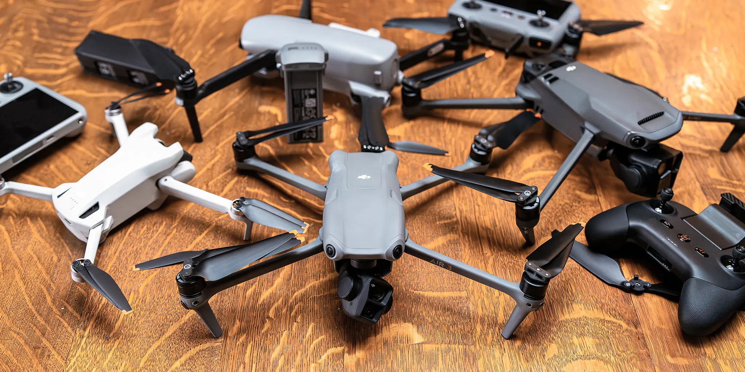

Slide 11
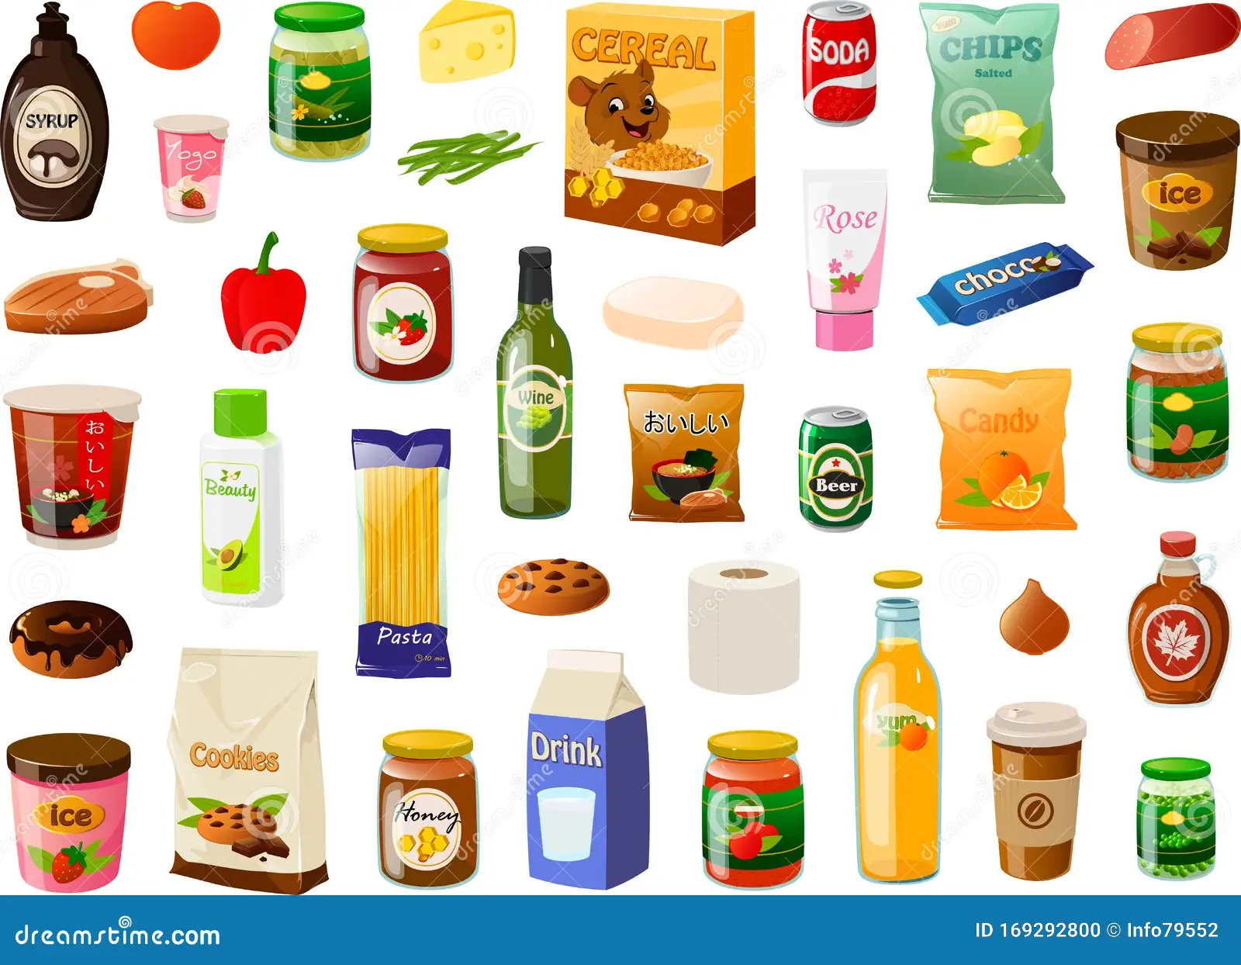

Slide 12


Slide 13
A certain type of objects
C++ ➔ Class
A common framework/specification to a certain type of objects, and their destinated behaviors

Slide 14
OO Principles
Data Abstraction
Polymorphism
Inheritance
Encapsulation

Slide 15
OO Programming in C++
Data Abstraction
Polymorphism
Inheritance
Encapsulation
class GPS{…}
latitude
longitude
https://github.com/sfelixwu/Person_and_Thing

Slide 16
What we learned today
C++ Class
Declaration (.h) and Definition (.cpp)
Constructor
How to create an object?
How to call a member function?

Slide 17
Objects/Classes
Data/attributes
Internal, external, inherited/protected
Methods (interface, member functions)
External, internal, inherited/protected, virtual

Slide 18
Objects/Classes
Data/attributes
Internal, external, inherited/protected
Methods (interface, member functions)
External, internal, inherited/protected, virtual
class class_name
{
private:
…
…
…
public:
…
…
…
};
latitude
longitude

Slide 19
Objects/Classes
Data/attributes
Internal, external, inherited/protected
Methods (interface, member functions)
External, internal, inherited/protected, virtual
class class_name
{
private:
…
…
…
public:
…
…
…
};

Slide 20
GPS.h GPS.o
Separate Compilation
class GPS_DD
{
private:
double latitude;
double longitude;
public:
explicit GPS_DD();
explicit GPS_DD(double, double);
double getLatitude();
double getLongitude();
double distance(GPS_DD);
void dump();
};
GPS_DD Nitin;
Nitin.dump();

Slide 21
Object-Oriented Paradigm
Object-oriented analysis and modeling
Object-oriented design
Object-oriented programming
Object-oriented languages/constructs

Slide 22
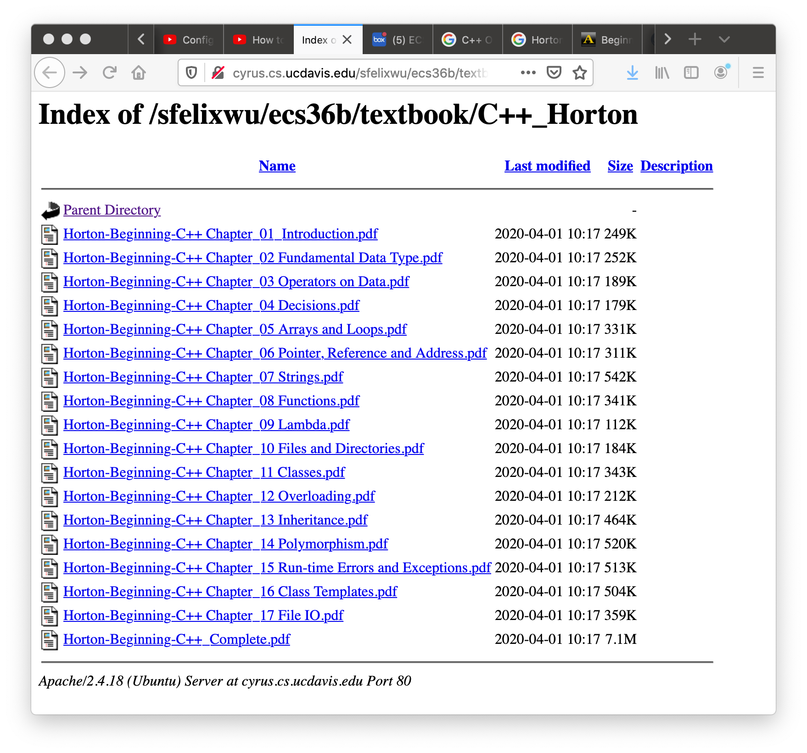

Slide 23
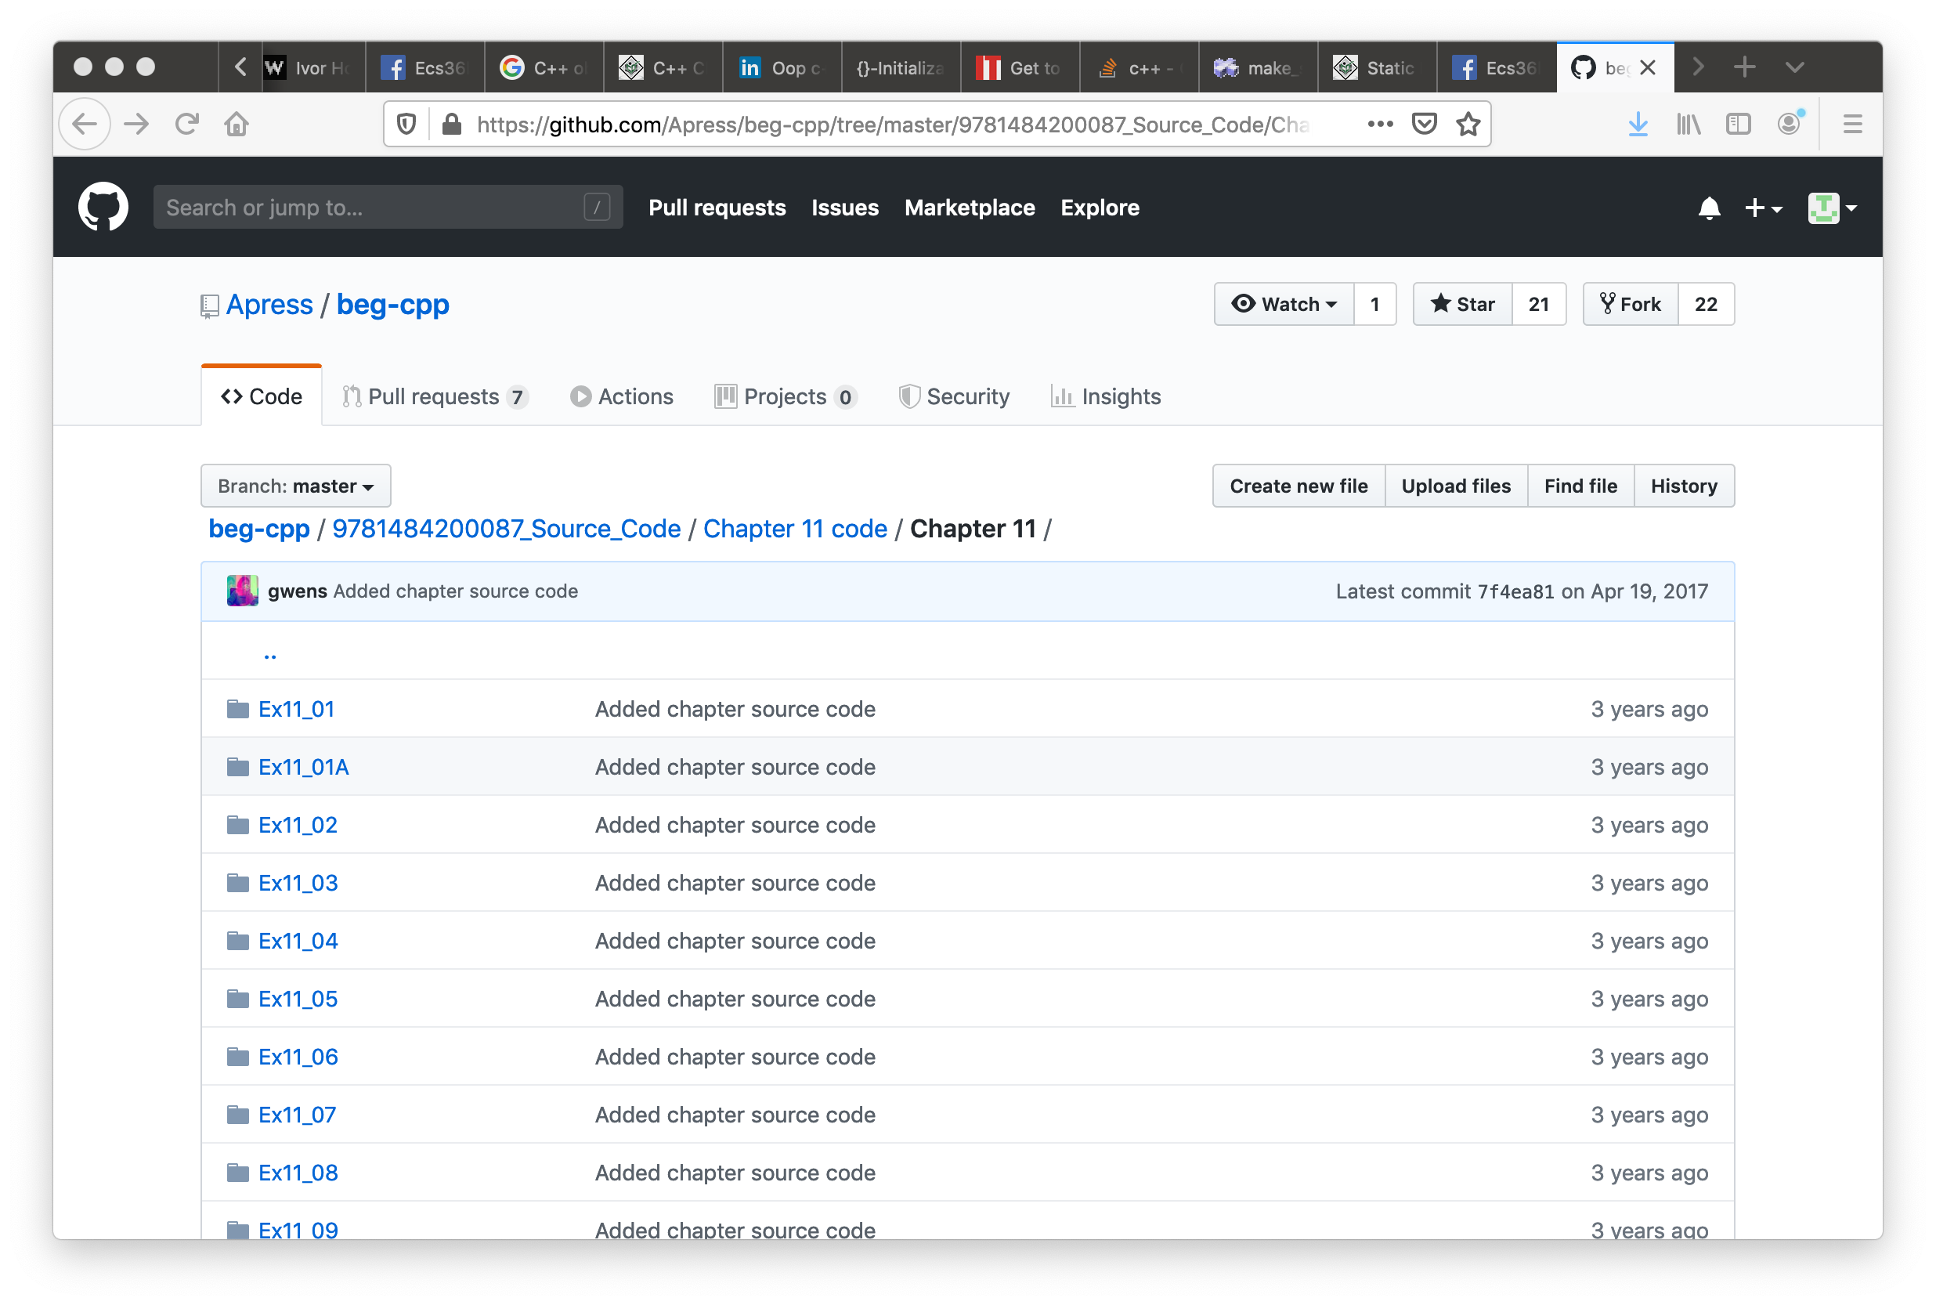

Slide 24
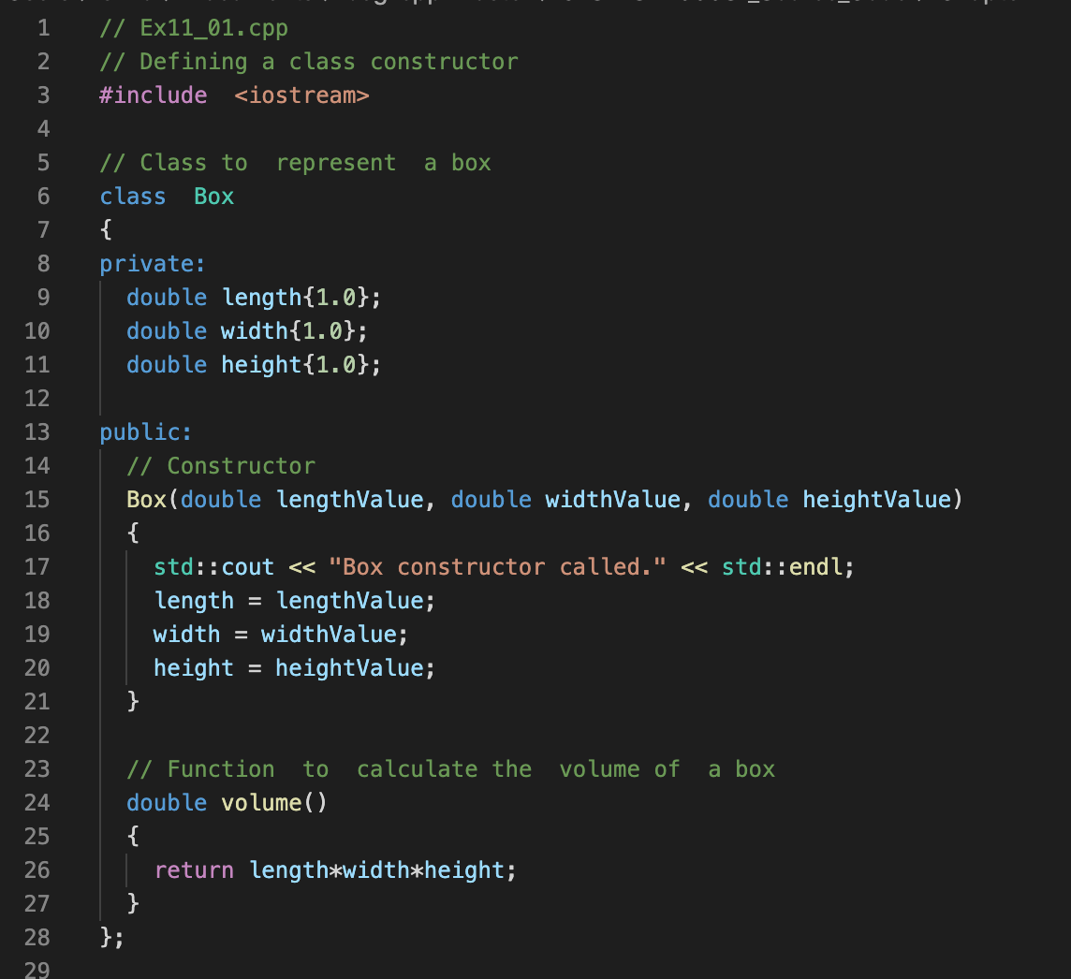

Slide 25
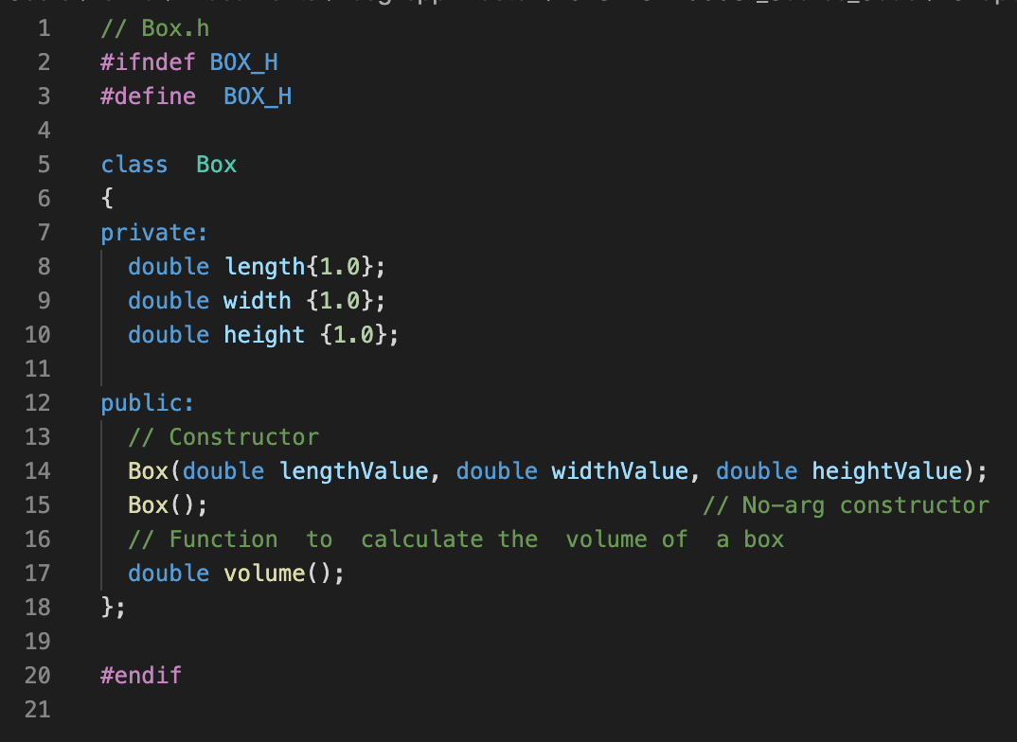

Slide 26
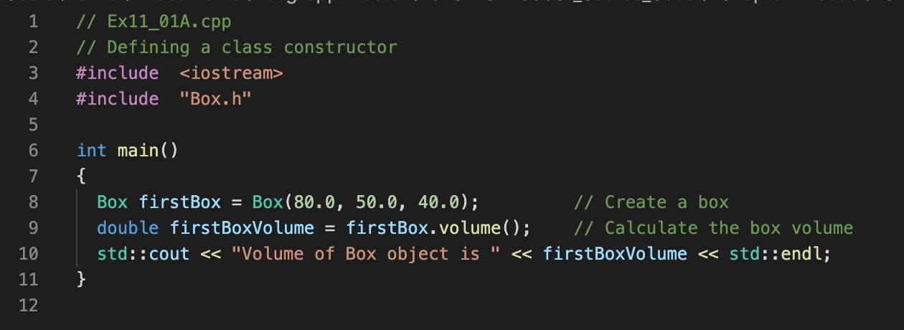
class Box;
C++ class, private and public
member functions
Constructors
V
length
width
height
C
C

Slide 27
class Box;
C++ class, private and public
member functions
Constructors
V
length
width
height
C
C

Slide 28
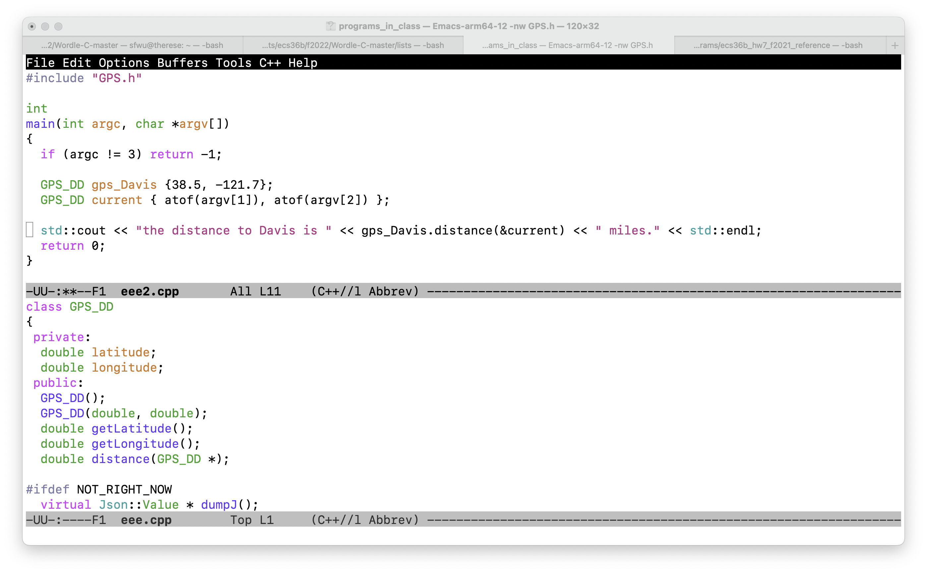

Slide 29
Function signature
Function name
Return data type
Input arguments and their data types.

Slide 30
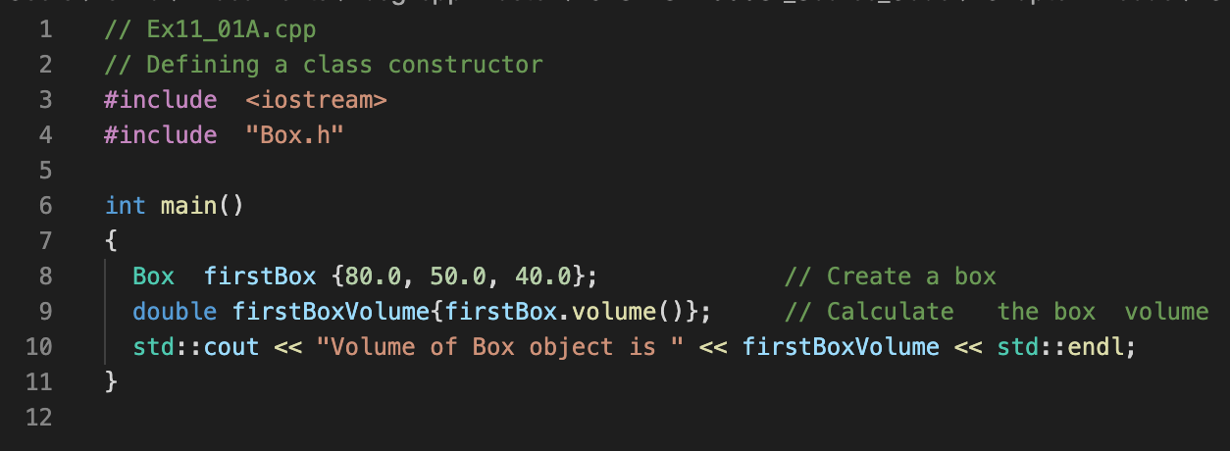
Felix’s version
Horton’s version

Slide 31
Felix’s version
Horton’s version

Slide 32
{ } Bracket Initialization
Available only after C++11
C++98 C++03 C++11 C++14 C++17 C++2a
g++ -std=c++2a Ex11_01A.cpp Box.cpp -o Ex11_01A

Slide 33
class Box;
C++ class, private and public
member functions
Constructors
Bracket Initialization
Namespace (Chapter 1, Horton)
V
length
width
height
C
C

Slide 34
Let us run some C++ programs!

Slide 35
double distance_calculated;
distance_calculated = gps_Davis.distance(current);
distance_calculated = gps_Davis.distance(GPS_DD {atof(argv[1]), atof(argv[2])});
distance_calculated = gps_Davis.distance({atof(argv[1]), atof(argv[2])});
distance_calculated = gps_Davis.distance({});

Slide 36
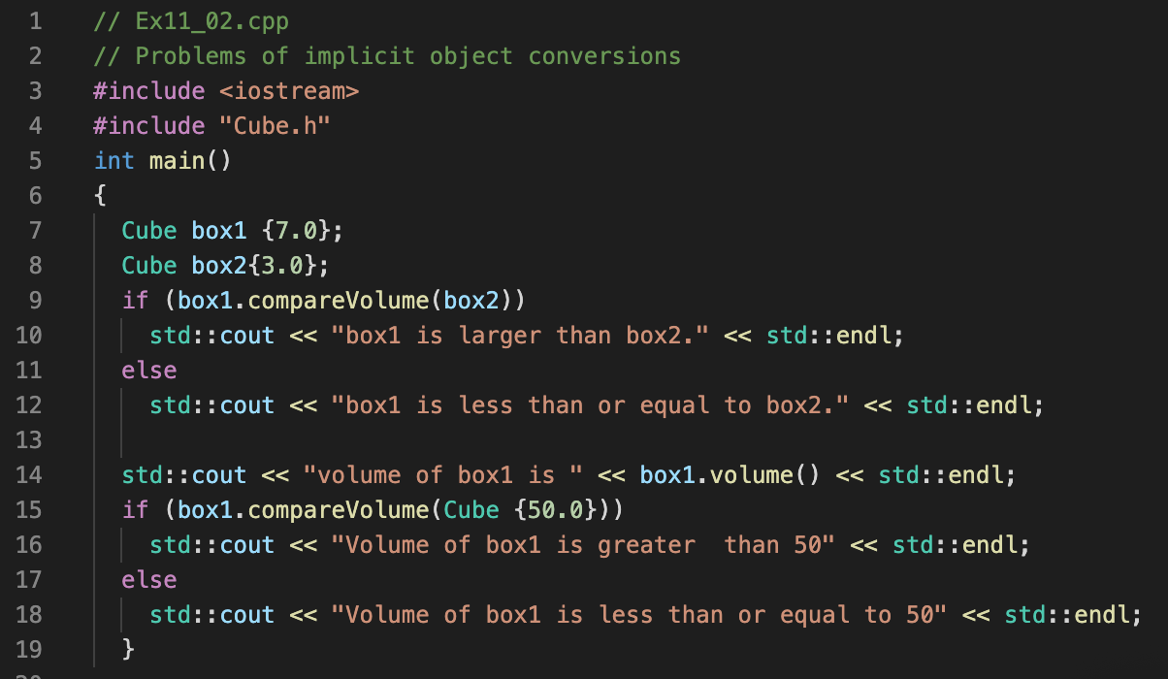
Good or bad?

Slide 37
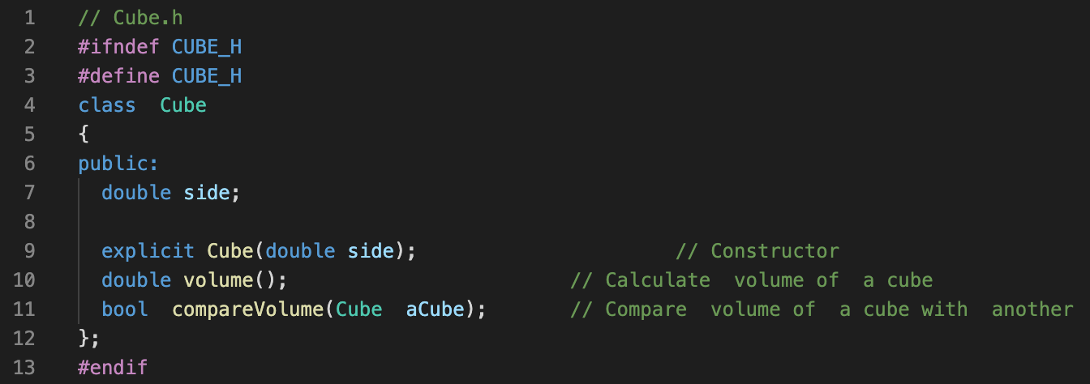
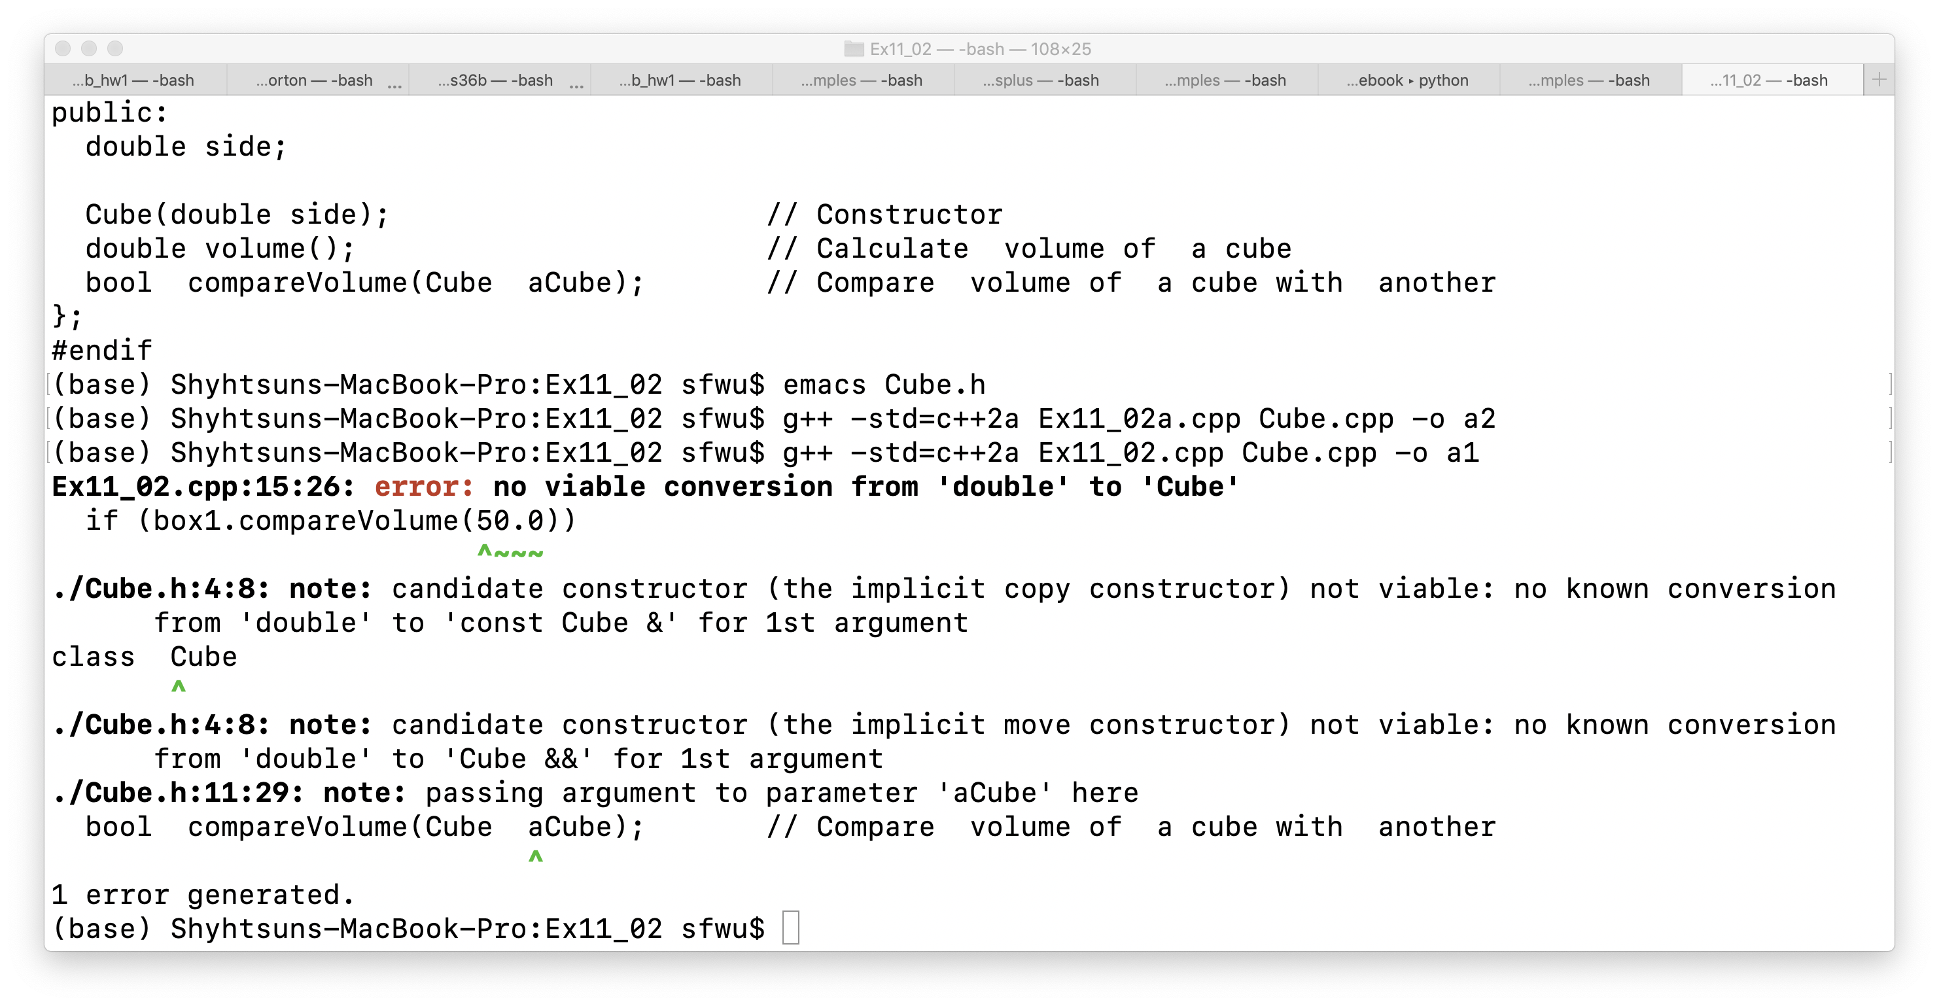

Slide 38
V
length
width
height
class
C
C
Can we track easily how many objects from this class have been created?
objects

Slide 39
V
length
width
height
Class Transaction
static variable
C
C
Can we track easily how many objects from this class have been created?
objects

Slide 40
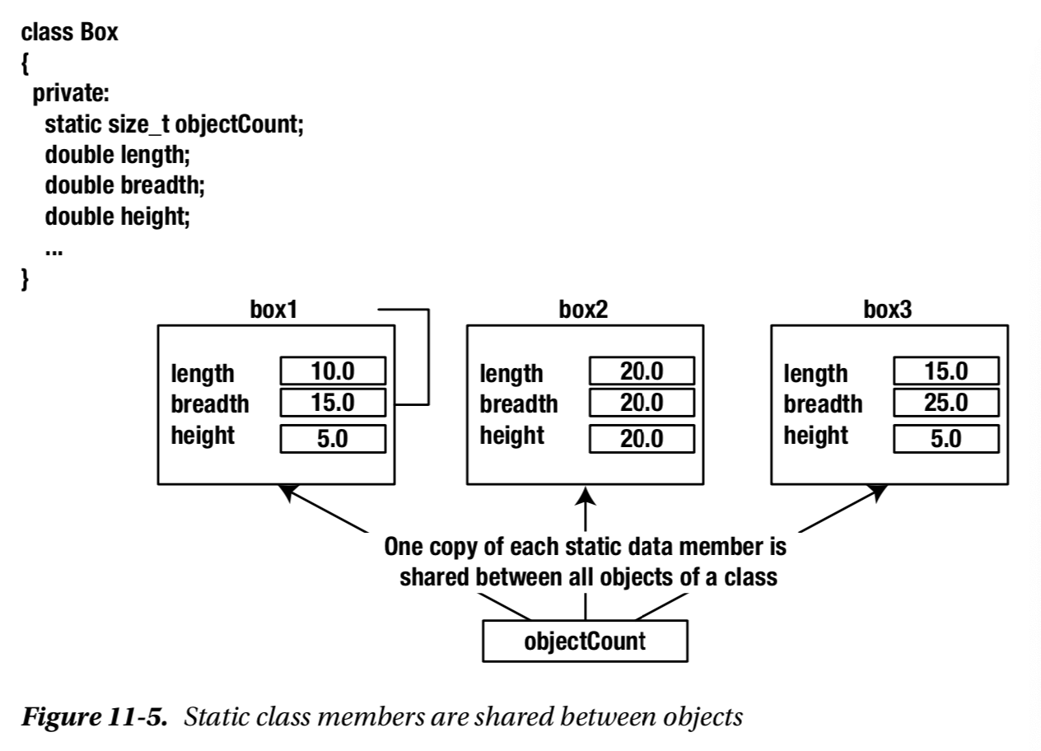

Slide 41
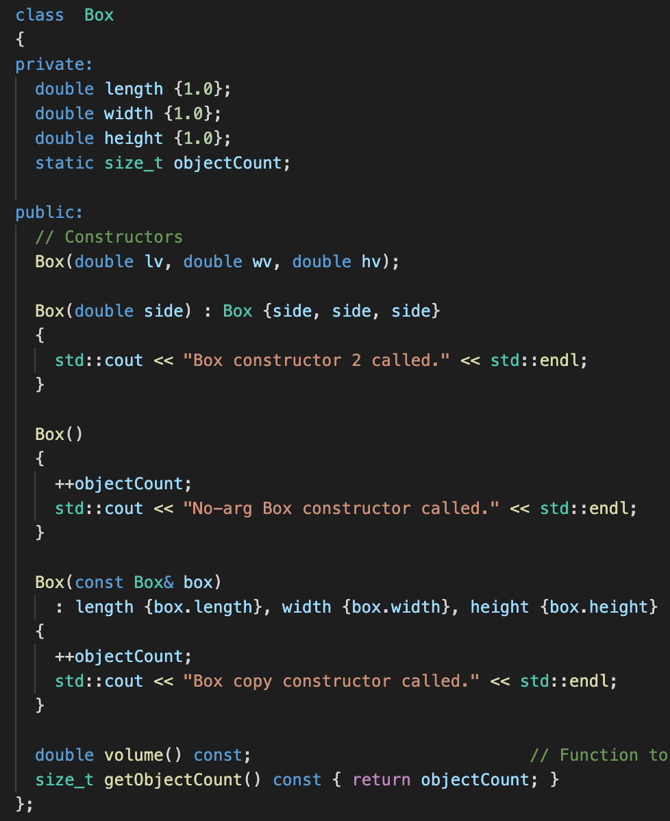

Slide 42
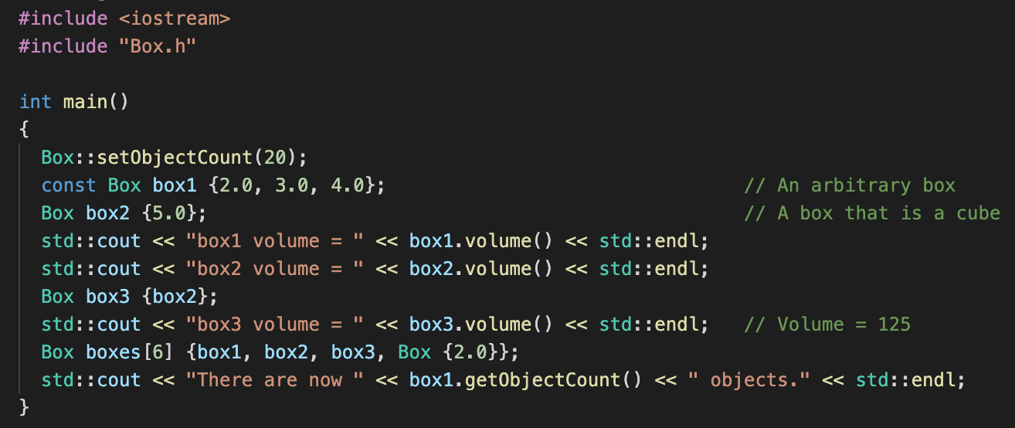
Accessing static variables before any object created

Slide 43
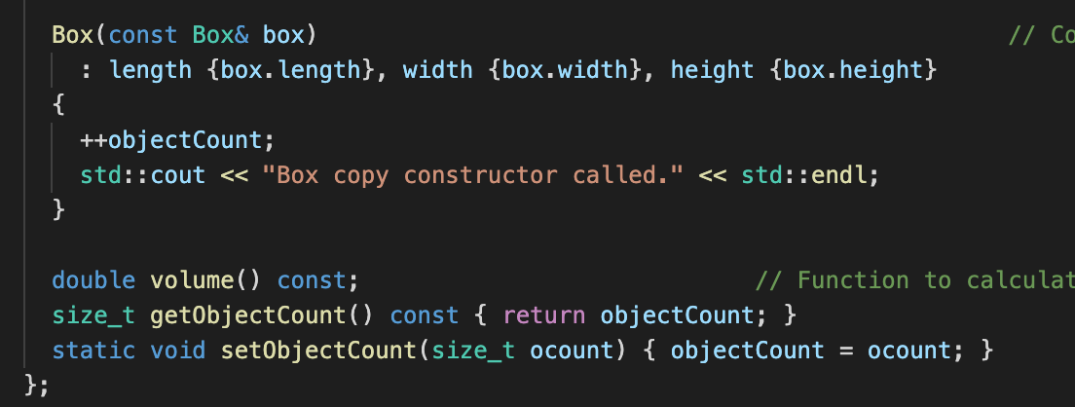
Box.h

Slide 44
#include "Transaction.h"
unsigned int Transaction::transaction_count { };
// unsigned int transaction_count = 0;
Transaction::Transaction(unsigned int arg_type)
{
Transaction::transaction_count++;
this->tr_type = arg_type;
}

Slide 45
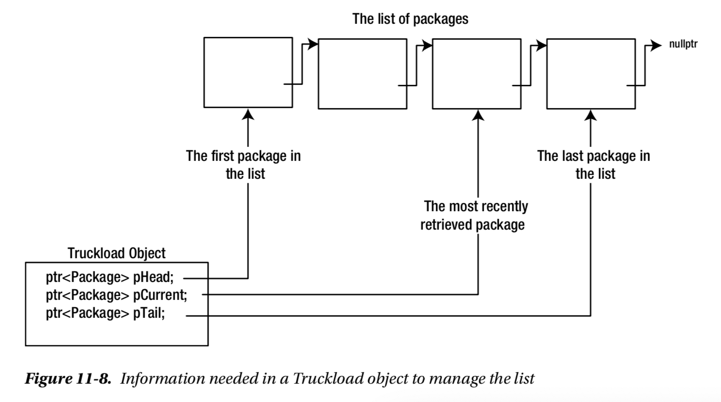

Slide 46
An Object
Integrity/Protection
Reusability
Abstraction

Slide 47
Two sides of OO*
Complexity of the Problem itself
Choosing the right-level of abstraction
Solving real problems!!
If you haven’t written the program, you don’t know what you are talking about!
Better Software Development

Slide 48
1GB
1GB
1GB
1GB
1GB
1GB
1GB
1GB
1GB
1GB
1GB
1GB
0.6GB
Movie FILE 12.7 GB, 13 chunks, 1GB
1GB
1GB
1GB
1GB
1GB
1GB
1GB
1GB
1GB
1GB
1GB
1GB
0.6GB
Movie FILE 12.7 GB, 13 chunks, 1GB

Slide 49
For a given file, move the r/w head to a position, and
Then we write a number of bytes.
Move to the beginning of the first chunk, and the beginning of
The 6th chunk, and write 1GB each
1GB
1GB

